Slide 1

NEWS SATIRE DETECTOR
Final Presentation
Gabriela Tanumihardja

Slide 2

Where We Left Off…
Satirical News:
Designed as social commentaries
Sometimes hard to spot
Predicting satirical nature from headlines
Data scraped from legitimate and satirical news sites

Slide 3




Project Framework
1
2
3
4
Data acquisition and cleaning
Train baseline models and evaluate
Train advanced models and deep learning models
Adjust data
Scrape headlines from four online news sources
Logit, SVM, Naïve Bayes, KNN, Random Forest
Resample by year and sources
AdaBoost, XGBoost, BERT model

Slide 4
Model Comparison
Model | Accuracies
 | Train | Test
Logistic Regression | 0.84 | 0.79
SVM | 0.9 | 0.78
Naïve Bayes | 0.8 | 0.77
AdaBoost | 0.73 | 0.76
XGBoost | 0.90 | 0.77
Random Forest | 0.99 | 0.76
BERT | 0.95 | 0.90
Best model – transfer learning using BERT pre-trained neural network
Bidirectional Encoder Representations from Transformer (BERT):
Developed by Google
12 layers, 110 M parameters
Takes account context into predictions

Slide 5
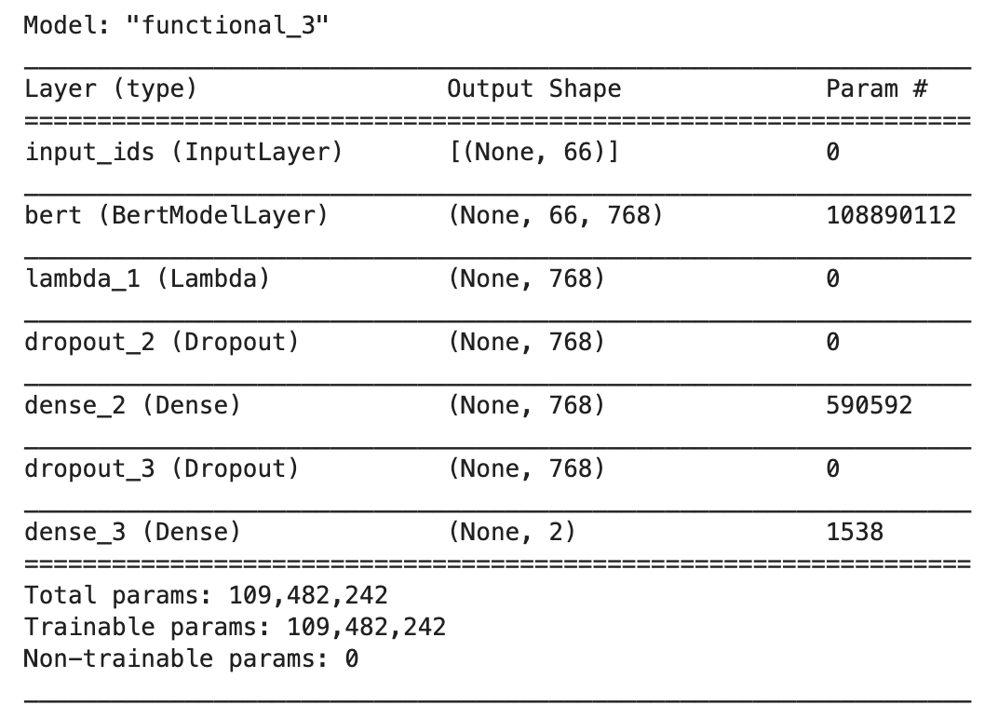
BERT Model
Fine tuning model:
Freeze original weights in BERT layer
Feed into softmax layer

Slide 6
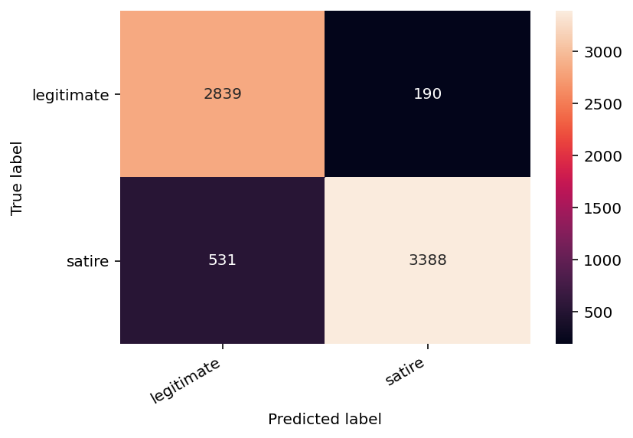
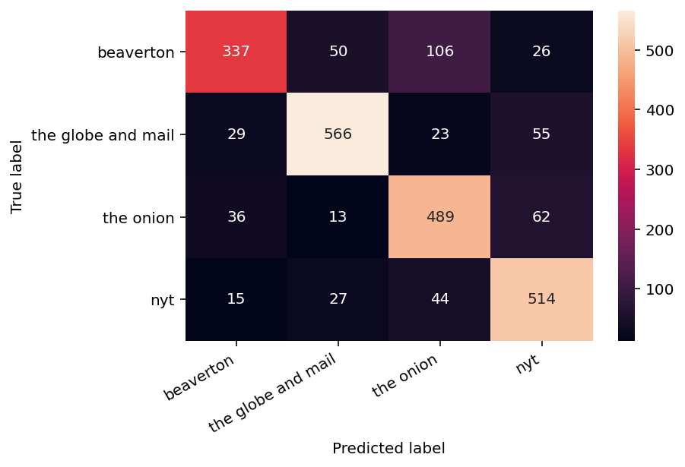
BERT Results
precision: 0.90
recall: 0.90
accuracy: 0.90
precision: 0.80
recall: 0.80
accuracy: 0.80

Slide 7

Serve up! What’s Next?
Using StreamLit to create an app
Build up
Model that could recommend similar articles of the opposite type?
Scrape and test/update using Babylon Bee & the Borowitz Report

Slide 8
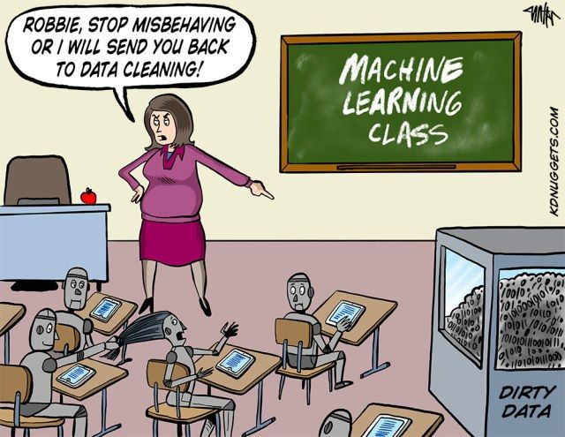

Q+A
Notes:
RNC Concludes With Massive Fireworks Display Inside Oval Office
Robots Inform Artificial Intelligence Researchers That They’ll Take It From Here

Slide 9
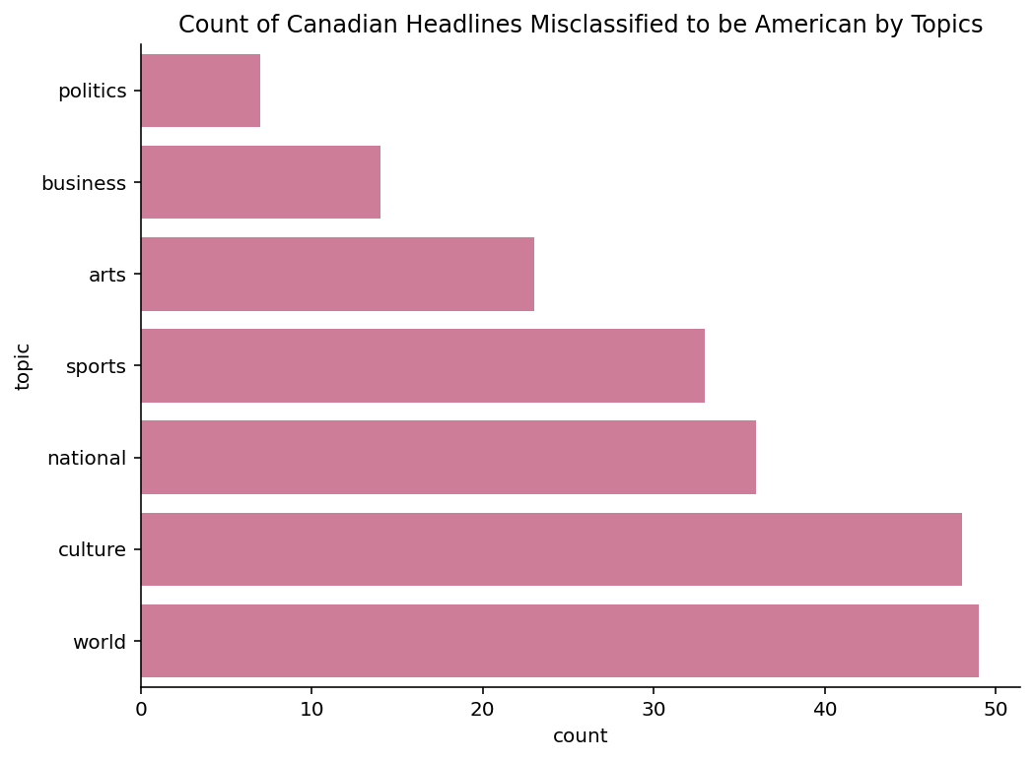
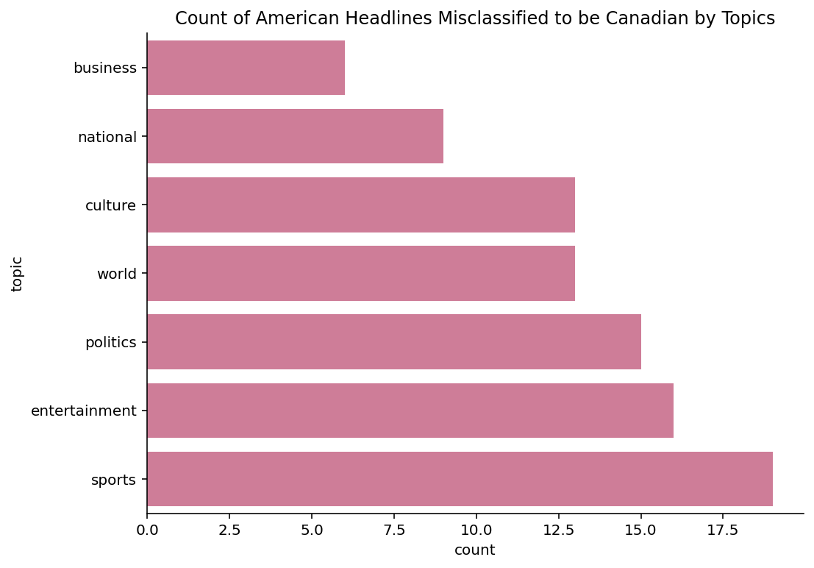
Supplementary Figures

Slide 10
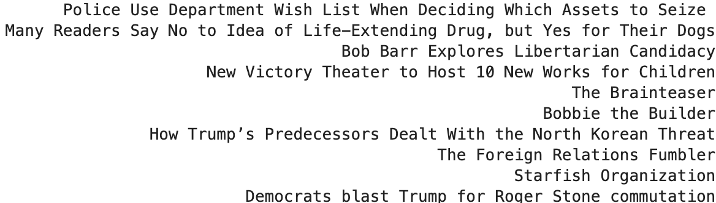
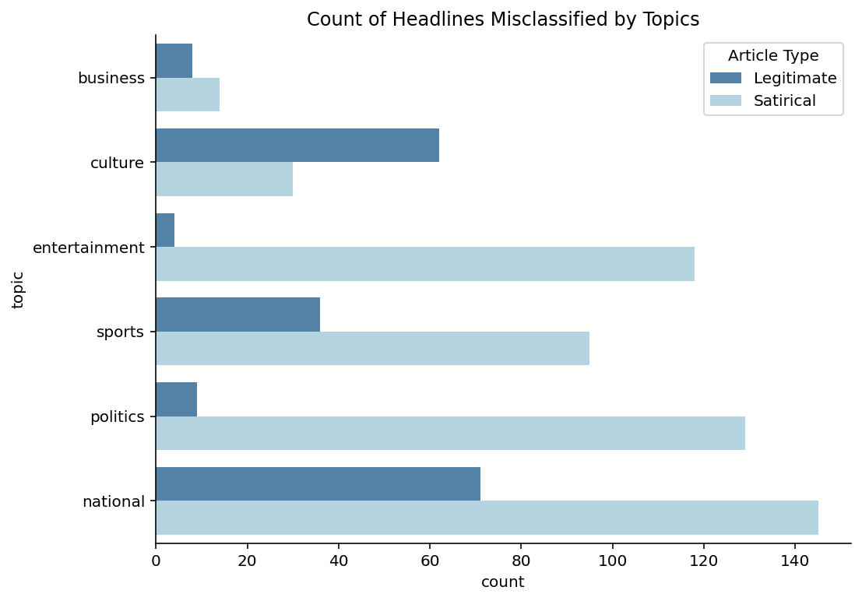
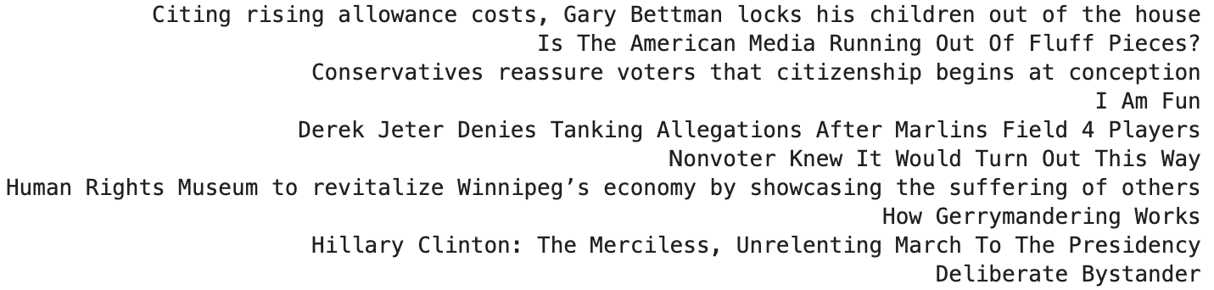
Supplementary Figures
Legitimate headlines classified as satirical
Satirical headlines classified as legitimate

